Slide 1
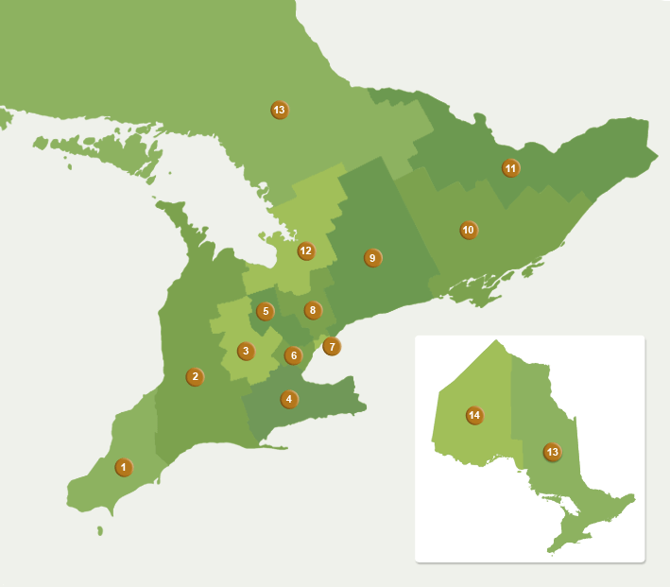

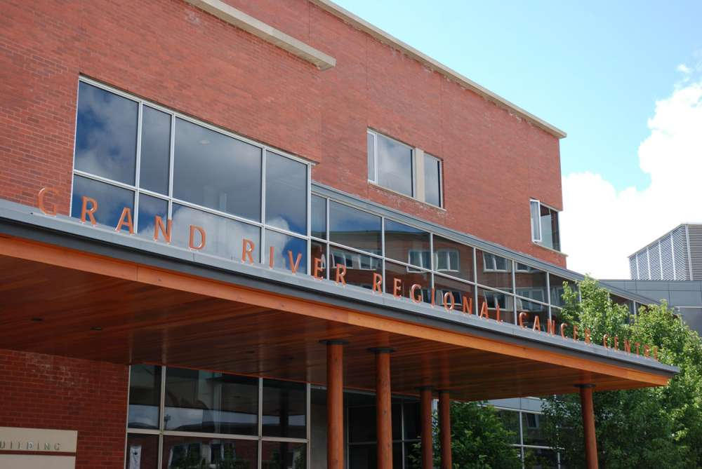
Radiation Therapy Emergency Treatment Preparedness (RT-EmP) -- What to Consider and How to Implement
Lixin Zhan
Grand River Regional Cancer Centre,
Kitchener, Ontario, Canada N2G 1G3

Slide 2
Factors to Consider for an Emergency Preparedness Plan
RISK is There!! Cyberattack, Natural Disaster, Technical Failure, and Others
How long/much can you afford the loss of RT access?
Geographical location / nearby centres
Patient volume
RT facilities: OIS, TPS, Linac etc, and treatment techniques
IT setup: on prem or cloud? virtual or physical? self managed or by someone else? IT support readily available?
Existing data format and location
Data to be prepared
Devices required and available
Budget !!!
Know your practical expectation
Know your RT
Know your IT
Know your data
Know what you need to acquire

Slide 3
Grand River Regional Cancer Centre (GRRCC)
Location: Kitchener (Southwest Ontario)
Patients: ~ 2200 annual
Plans: ~ 3600 annual
Treatment: ~ 150 daily
OIS: ARIA 16.1
TPS: Eclipse 16.1
Linac: 5x TrueBeam 2.7
Brachy: 1x Bravos
Ortho: 1x Xstrahl 300
IDEALLY:
Complete mini RT environment (OIS+TPS+Calc), BUT -- technique, budget, licensing, vendor support, IT involvement
PRACTICALLY:
Treatment Contingency – NO Tx GAP!!
* under treatment
* plan received treat approval
* no RT plan: patient transfer
* survive for 5 days
* DICOM RT mode (file based)
Newmarket
Sunnybrook
Grand River
Princess Margaret
Peel
Niagara
London
Juravinski

Slide 4
CT Sim
Firewall
AD
ARIA
Linac
DNS
ARIA Replication
Brachy
Cerner
RT-EmP Data Helper
Ortho
Backup Repo 01
Veeam
SQL Query
Files: Doc, DCM
Faked I: Drive
Backup and Replication
Backup Repo 02
Immutable
Backup Repo 03
Harden & Imm
Emergency Preparedness System Behind Firewall
DICOM for File Mode Treatment

Slide 5
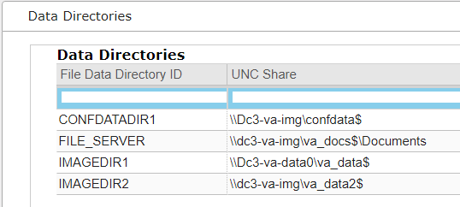
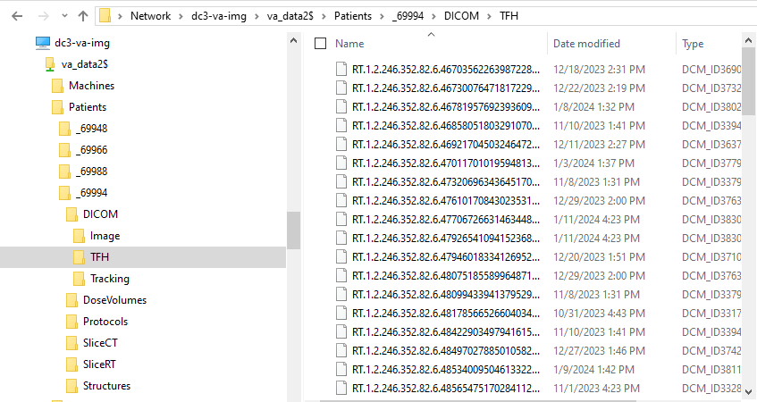
ARIA Data Organization
Database: MS SQL 2014SP3CU4
VA_DOC$: Documents (*.doc, *.pdf etc.)
VA_DATA$:
-- Patients/_#####
* SliceCT
* SliceRT
* Structures
* DoseVolumes
* Protocols
* DICOM
* Image
* Tracking
* TFH

Slide 6
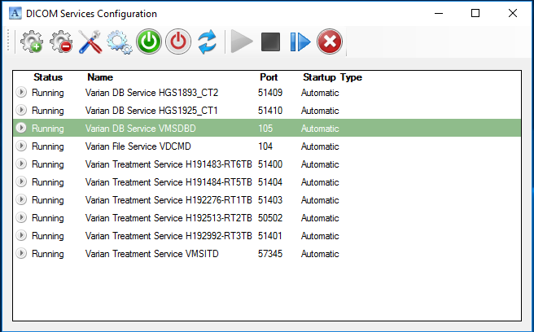
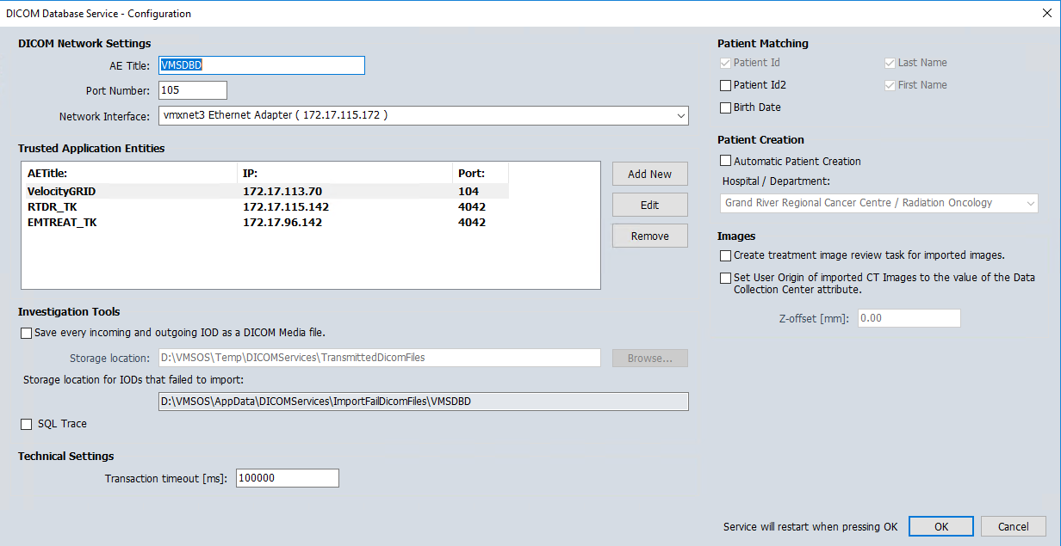
ARIA Data Organization
Database: MS SQL 2014SP3CU4
VA_DOC$: Documents (*.doc, *.pdf etc.)
VA_DATA$:
-- Patients/_#####
* SliceCT
* SliceRT
* Structures
* DoseVolumes
* Protocols
* DICOM
* Image
* Tracking
* TFH

Slide 7
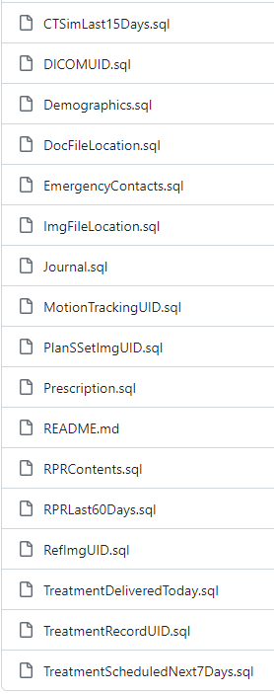
Data Required for Emergency Treatment
Patient Queries:
Patients with RPR in the last two months
Patients have CTSim done in the last two weeks
Patients have RT Plan Reviewed and Approved in the last two weeks
Patients received treatment today
Patients have treatment scheduled for the next 7 days
RPR Info (Questionnaires)
Quick Notes: setup info, treatment notes, physician orders etc. (Journal)
Prescription
Patient demographics, contacts, and health insurance info
Data Moving: Patient Scheduled for the next 7 days:
Files for DICOM RT mode treatment: DICOM CT, RP, RS, RI
Other DICOM files: Tx Records, RGSC Motion Tracking
Patient documents: CTSim/planning notes, QA doc etc.

Slide 8
CT Sim
Firewall
AD
ARIA
Linac
DNS
ARIA Replication
3.b
Brachy
Cerner
RT-EmP Data Helper
Ortho
1
2
Backup Repo 01
Veeam
3.a
3.c
4
SQL Query
Files: Doc, DCM
Faked I: Drive
Backup and Replication
Backup Repo 02
Immutable
Backup Repo 03
Harden & Imm
Emergency Preparedness System Behind Firewall
DICOM for File Mode Treatment

Slide 9
ARIA System
ARIA DB
VMSDBD
File Server
3.b
Data Helper
Firewall
4
1.a
1.b
1.c
1.d
2
3.a
3.c
Patient List and Info
Questionnaires and Journal
RP/CT/RS/RI SeriesUID
Files and Locations
DICOM RP/CT/RS/RI
Doc and DICOM Files
Isolated RT Emergency Preparedness Module
RT-EmP data retrieving illustration. After NIC enabled at scheduled time, 1.a-1.d: SQL queries of Aria DB; 2: DICOM C-MOVE based on SeriesUID queried from step 1.c; 3.a: files copy request based on the result of 1.d; 3.b: file copy from RT file/image server; 3.c: file copy from data helper; 4: send a copy of files from all previous steps to data helper. NIC will be disabled after all steps.

Slide 10
Technical Requirements
Isolated: behind a firewall
Outbound connection only; No inbound connection
Air-gapped/offline when no data transfer
Minimal impact on clinical RT environment
No attack vector should be introduced to RT servers
Up-to-date patient data retrieval
Active Directory Independent!!!
Aria DB Readonly account, for SQL query
Aria DICOM DB Service (VMSDBD) access
Firewall port forwarding for DICOM retrieving (movescu)
Data Helper on the domain with SSH service (win2019/win2022)
Standalone routing setup for Linac and server network

Slide 11
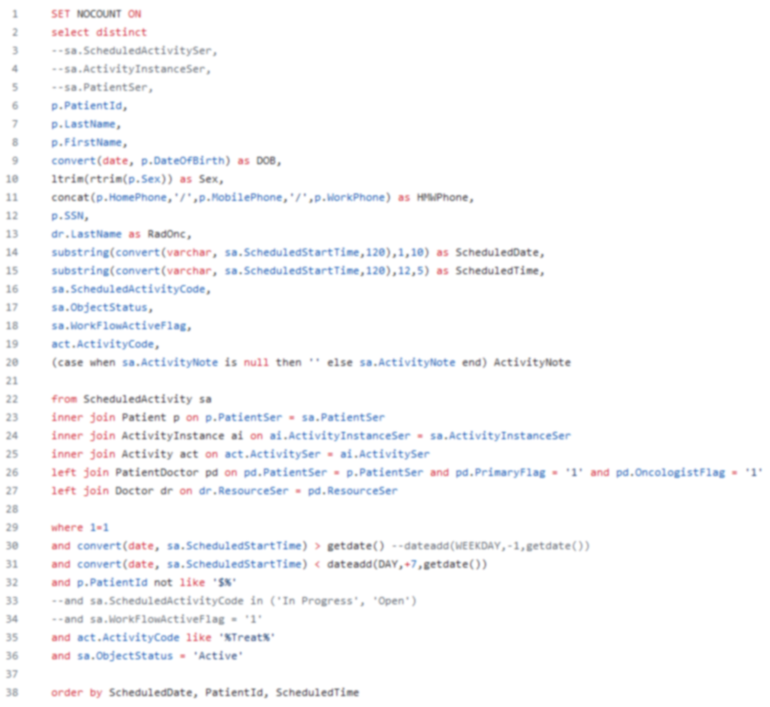
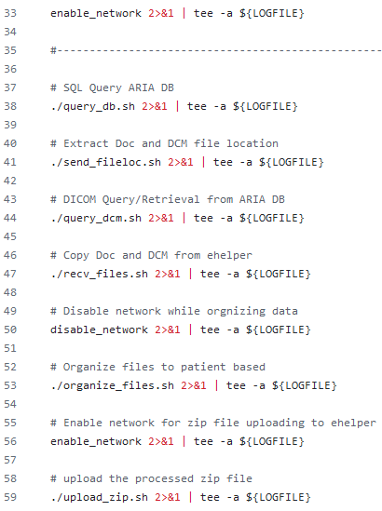
Implementations:
RT-EmP WS: Ubuntu 22.04
Main Program: Bash script
DB Query: SQL Script
DICOM Retrieval: DCMTK
Data Helper WS: Windows 2022
Data Helper Script: PowerShell
Firewall Router: Netgate 6100
Src Control Repo: GitHub
Data Format: CSV, DCM

Slide 12
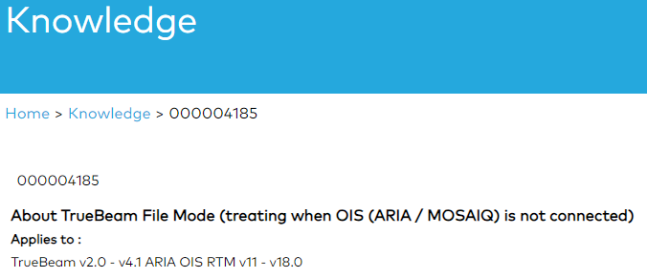
DICOM RT Mode -- TrueBeam
To use File Mode the following is required:
DICOM Plan files uploaded to the I: drive. These must have been exported from the OIS in advance
Access to the network I: drive (in order to access Patient DICOM files) from the TrueBeam
Access to OSP/VSP for User Rights
If OSP is offline, credentials are held / cached locally on the TrueBeam for 5 days
If the network is down (1), or there is no connectivity to the I: drive (2), or the DICOM Plan files were not exported from the OIS system in advance (3), then there is no workaround to treat patients on the TrueBeam
File Mode Has Some Risks, such as the potential to treat the wrong patient, wrong anatomy or wrong field, if care is not taken

Slide 13
CBCT Recon WS
Treat Console WS
IRM WS
Service WS
Imaging Network Switch
Console Network Switch
Juniper
TrueBeam
TrueBeam vLan
TrueBeam ←→ Servers Switch/Router
Varian Server vLan
Supporting WS
I: Drive Server
Copy to
RT-EmP Treatment Module
RT-EmP Data Query and Storage

Slide 14
Summary
Risk of Cyberattack is there!! Face it and prepare for it!
BACKUP + Immutable/Air-gapped (!!!) is NOT enough!
Contingency Plan is different for each RT clinics
Factors for CP: Location, Pt Volume, RT facilities, IT, vendor
Emergency Treatment Implementation:
Know your data, RT devices, IT management
Know your requirements for emergency treatment
Minimal impact to clinics
Do not introduce risks to existing RT environment
Isolated, air-gapped, and independent of existing IT infra.
TrueBeam DICOM RT Mode:
DICOM RP/RS/CT/RI --- daily data retrieval
Login Credential --- TrueBeam cached locally for 5 days
I: Drive Dependency --- faked I: drive with correct routing
Pt and Tx Information --- DB query and direct file copy
RT-EmP for GRRCC
RT-EmP + Guidelines + Practice
Veeam + On-prem Immutable
RT-EmP
DICOM RT mode
All Varian + IS/Physics shared IT
Isolated, air-gapped, IT independent
Data retrieving after clinical hours
Yes. Standalone system
Firewall & offline + faked share
DCMTK + VMSDBD for DICOM
Tested
Implemented and Tested
SQL query + Data Helper

Slide 15
Perfect is the Enemy of Good! Start Simple! Start Now!!!
Acknowledgements
Ernest Osei (Head of Physics)
Sara Kaune (Director)
Paule Charland (Physicist)
Johnson Darko (Physicist)
Andre Fleck (Physicist)
Runqing Jiang (Physicist)
Ronald Snelgrove (Physics Assistant)
Leah Wolfe (Therapist)
Gregory Salomons (Physicist@Kingston)
Members of Disaster Recovery Forum

Slide 16
What is Next?
Setup emergency Response Committee
Internal Communication channel, out of hospital network, such as WhatsApp
Patient triage standard under emergency
Provincial committee for RT emergency, in coordinating between institutions, for such as patient transfer
Prior agreement for prioritizing patient categories
Scheduled training for emergency cases
Setup emergency protocols/guidelines
DB dump for reconstructing DB
DB transaction log backup for every 15(?) minutes
Trajectory log backup every 15(?) minutes
Further hardening
An isolated full but mini RT environment (OIS+TPS+Calc)
And more …

